Slide 1
Different Reconstruction Techniques on Sinogram Image
Rohit Das
Advised By – Prof. Chiou-Shann Fuh
61047086s@ntnu.edu.tw
+886-0905023713

Slide 2
Research progress
Filtered Back Projection (FBP)

Slide 3
Filtered Back Projection
FBP also known as Filtered Back Projection is an image reconstruction method widely used in X-ray CT.
Most commonly used reconstruction technique in cone beam CT.
As the name suggests, we apply a filter for removing the halo noise and apply Backprojection algorithm.
Since it is a linear method, we can also use the filter after implementing Backprojection.

Slide 4
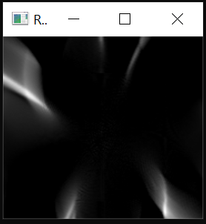
Filtered Back Projection
Previously, we couldn’t been able to generate the image due to extensive bugs in code.
Also there was a problem due to malfunction of the iteration.
The iterative way
Implementing the Equation

Slide 5
Filtered Back Projection
Finally found the solution

Slide 6

Steps of FBP
Original Image

Slide 7



Steps of FBP
179$°$
0$°$
Sinogram
Create Sinogram using Radon Transform

Slide 8
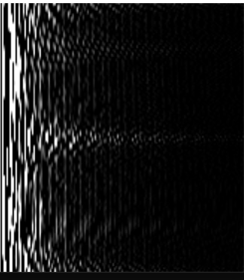
Steps of FBP
Forward Fourier Transform
Forward Fourier Transform for filtering the halo noise frequency

Slide 9
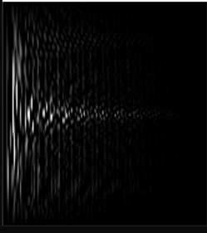
Steps of FBP
After applying Hamming Filter
High pass filter for better contrast
Hamming Filter
Ham Filter
Ram Filter
Cosine Filter
Shepp-Logan Filter

Slide 10

Steps of FBP
Inverse Fourier Transform
Applying Inverse Fourier Transform to reconstruct back to original state

Slide 11
Steps of FBP
Expected image after Backprojection
After Applying Backprojection algorithm

Slide 12
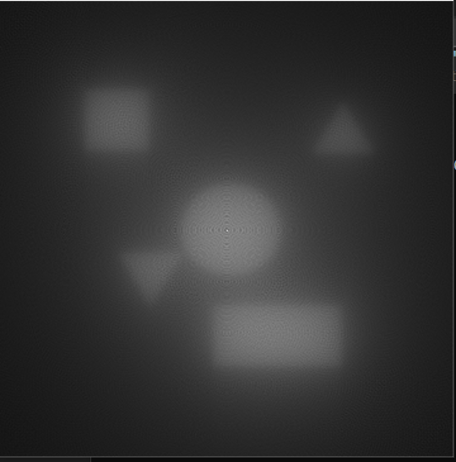
Our Result
Without any filter

Slide 13
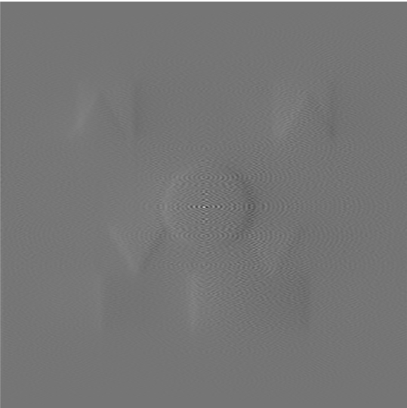
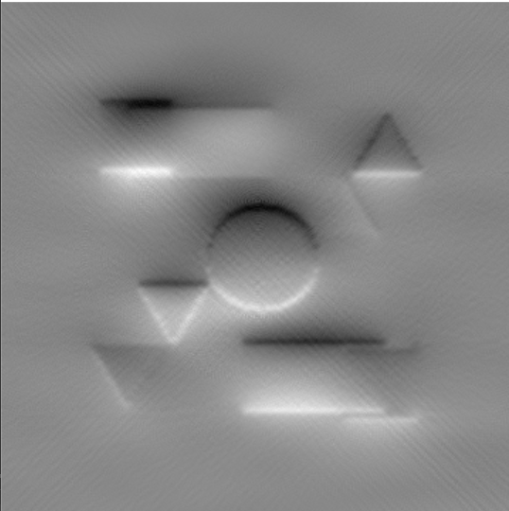
Our Result
Applying Hamming Filter after Sinogram Generation
Hamming Filter after backprojection

Slide 14
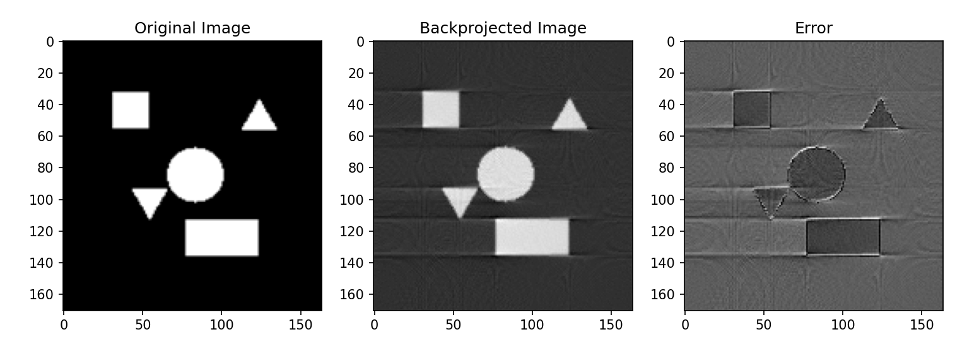
Our Result
Another Experiment in Python using Ramp Filter

Slide 15
Conclusion
FBP though easy is very tricky to implement.
MART and ART are better than FBP in implementation.
Because we can provide some prior information before implementing ART/MART.
For these kinds of problems, it is better to reconstruct based on prior information rather than implementing FBP which is totally linear operation .
The only place we can interfere in FBP is the filter which is also limited.
Ramp Filter is the best for FBP and so does other high pass filters but we believe we cannot totally remove the halo noise even after Fourier Transform because of Central Slice Theorem.
Did we mention that the projection is non-iterative!
FBP: Filtered back Projection
MART: Multiplicative Algebraic Reconstruction Technique
ART: Algebraic reconstruction Technique

Slide 16
Thank You!

